Slide 1
Probability of an American Roulette Wheel
Albano Gozzarelli

Slide 2
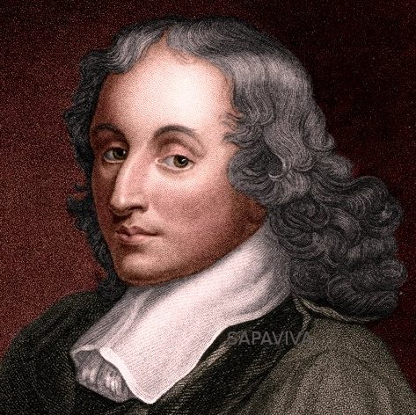
History of the Roulette Wheel
Created by French physicist, inventor, and mathematician Blaise Pascal in 1655
Attempted to make perpetual motion machine
0 was added in 1842 for King Charles III of Monaco
Gave the house better odds
King Charles III used it to get Monaco out of financial trouble
Monte Carlo became an international gambling destination
00 was added in the American table in the late 1800s

Slide 3

Rules of Roulette
Players place two types of bets: inside and outside
Outside bets are higher odds
Inside bets are lower odds, but greater reward
38 slots numbered from 1-36 (including 0 and 00)
0 and 00 are green
Other numbers are split randomly between red and black

Slide 4
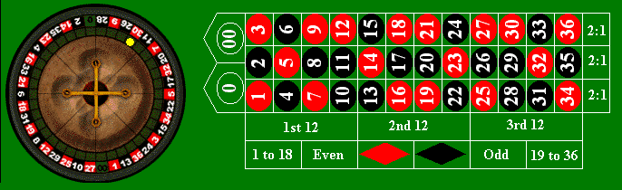
Outside Bets and Probabilities
Column bet
Covers an entire column of numbers (12 total)
Payout is 2:1 while odds are 31.6%
Dozen bet
Covers any 12 numbers
Payout is 2:1 while odds are 31.6%
Bet on color
Covers either black or red
Payout is 1:1 while odds are 47.4%

Slide 5
Outside Bets and Probabilities
Bet on odd/even
Covers either all even or all odd numbers
Payout is 1:1 while odds are 47.4%
Low bet
Covers numbers 1-18
Payout is 1:1 while odds are 47.4%
High bet
Covers numbers 19-36
Payout is 1:1 while odds are 47.4%

Slide 6
Inside Bets and Probabilities
Straight up bet
Covers a single number
Payout is 35:1 while odds are 2.6%
Split bet
Covers two adjacent numbers (eg 14 and 15)
Payout is 17:1 while odds are 5.3%
Street bet
Covers a row (3 total)
Payout is 11:1 while odds are 7.9%

Slide 7
Inside Bets and Probabilities
Corner bet
Covers 4 numbers in a corner
Payout is 8:1 while odds are 10.5%
Five bet
Covers 0, 00, 1, 2, 3
Payout is 6:1 while odds are 13.2%
Line bet
Covers two rows containing three numbers each
Payout is 5:1 while odds are 15.8%

Slide 8
Why the Casino Wins
Total of 38 total possibilities
All payouts are calculated using the 36 number set
1:1 payouts have less than 50% chance
2:1 payouts have less than 33% chance
Martingale Algorithm/Strategy
Play 5 games with 1:1 payout
3.125% chance of winning
Play 10 games with 2:1 payout
0.0017% chance of winning them all
Chance of being struck by lightning
0.0065%

Slide 9
Works Cited
“The History of Roulette.” Crescent School Gaming And Bartending, crescent.edu/post/the-history-of-roulette.
“Roulette Inside & Outside Bets: The Complete Guide - Caesars Games.” Caesars Games, 16 Nov. 2017, https://www.caesarsgames.com/2017/11/16/roulette-inside-and-outside-bets/

